Slide 1
NORMALIZATION
N. HARIKA (CSC)

Slide 2
Normalization
We discuss four normal forms: first, second, third, and Boyce- Codd , fourth normal forms
1NF, 2NF, 3NF, BCNF and 4NF.
Normalization is a process that “improves” a database design by generating relations that are of higher normal forms.
The objective of normalization:
“to create relations where every dependency is on the key, the whole key, and nothing but the key”.
NORMALIZATION

Slide 3
There is a sequence to normal forms:
1NF is considered the weakest,
2NF is stronger than 1NF,
3NF is stronger than 2NF, and
BCNF is considered the strongest,
4NF is considered the higher normal form.
Also,
any relation that is in 4NF, is in 3NF;
any relation that is in BCNF, is in 3NF;
any relation in 3NF is in 2NF; and
any relation in 2NF is in 1NF.
NORMALIZATION

Slide 4
Normalization
1NF
a relation in 4NF, is also in 3NF
a relation in BCNF, is also in 3NF
a relation in 3NF is also in 2NF
a relation in 2NF is also in 1NF
2NF
3NF
BCNF
4NF
NORMALIZATION

Slide 5
We consider a relation in BCNF to be fully normalized.
The benefit of higher normal forms is that update semantics for the affected data are simplified.
This means that applications required to maintain the database are simpler.
A design that has a lower normal form than another design has more redundancy. Uncontrolled redundancy can lead to data integrity problems.
First we introduce the concept of functional dependency
NORMALIZATION

Slide 6
Functional Dependencies
Functional Dependencies
We say an attribute, B, has a functional dependency on another attribute, A, if for any two records, which have
the same value for A, then the values for B in these two records must be the same. We illustrate this as:
A → B
Example: Suppose we keep track of employee email addresses, and we only track one email address for each employee. Suppose each employee is identified by their unique employee number. We say there is a functional dependency of email address on employee number:
employee number → email address
NORMALIZATION

Slide 7
Functional Dependencies
EmpNum
EmpEmail
EmpFname
EmpLname
123
jdoe@abc.com
John
Doe
456
psmith@abc.com
Peter
Smith
555
alee1@abc.com
Alan
Lee
633
pdoe@abc.com
Peter
Doe
787
alee2@abc.com
Alan
Lee
If EmpNum is the PK then the FDs:
EmpNum → EmpEmail
EmpNum → EmpFname
EmpNum → EmpLname
must exist.
NORMALIZATION

Slide 8
Functional Dependencies
EmpNum → EmpEmail
EmpNum → EmpFname
EmpNum → EmpLname
3 different ways you might see FDs depicted
EmpEmail
EmpNum
EmpFname
EmpLname
EmpNum EmpEmail EmpFname EmpLname
NORMALIZATION

Slide 9
Determinant
Functional Dependency
EmpNum → EmpEmail
Attribute on the LHS is known as the determinant
EmpNum is a determinant of EmpEmail
NORMALIZATION

Slide 10
Partial dependency
A partial dependency exists when an attribute B is functionally dependent on an attribute A, and A is a component of a multipart candidate key.
InvNum
LineNum
Qty
InvDate
Candidate keys: {InvNum, LineNum} InvDate is partially dependent on {InvNum, LineNum} as InvNum is a determinant of InvDate and InvNum is part of a candidate key
NORMALIZATION

Slide 11
Transitive dependency
Transitive dependency
Consider attributes A, B, and C, and where
A → B and B → C.
Functional dependencies are transitive, which means that we also have the functional dependency A → C
We say that C is transitively dependent on A through B.
NORMALIZATION

Slide 12
Transitive dependency
EmpNum → DeptNum
EmpNum EmpEmail DeptNum DeptNname
DeptNum → DeptName
EmpNum EmpEmail DeptNum DeptNname
DeptName is transitively dependent on EmpNum via DeptNum
EmpNum → DeptName
NORMALIZATION

Slide 13
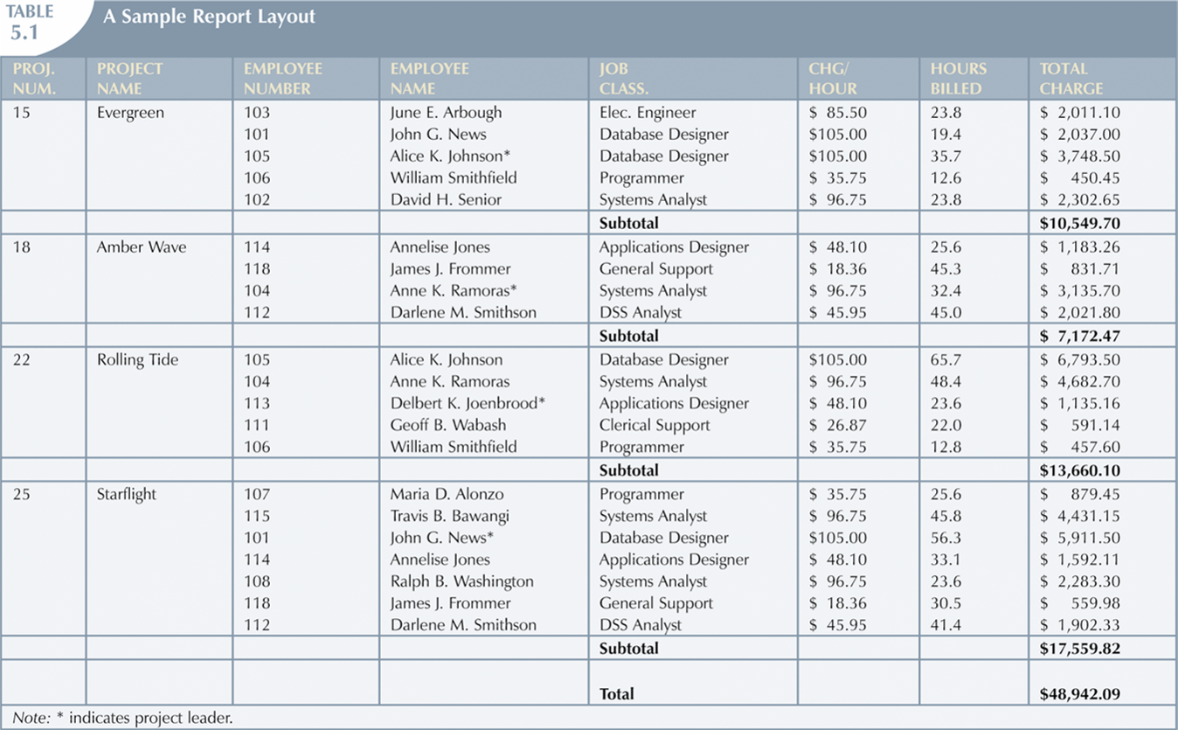
The Need for Normalization
NORMALIZATION

Slide 14
The Normalization Process
Each table represents a single subject
No data item will be unnecessarily stored in more than one table
All attributes in a table are dependent on the primary key
NORMALIZATION

Slide 15
Conversion to First Normal Form
Repeating group
Derives its name from the fact that a group of multiple entries of same type can exist for any single key attribute occurrence
Relational table must not contain repeating groups
Normalizing table structure will reduce data redundancies
Normalization is three-step procedure
Step 1: Eliminate the Repeating Groups
Present data in tabular format, where each cell has single value and there are no repeating groups
Eliminate repeating groups, eliminate nulls by making sure that each repeating group attribute contains an appropriate data value
15
NORMALIZATION

Slide 16
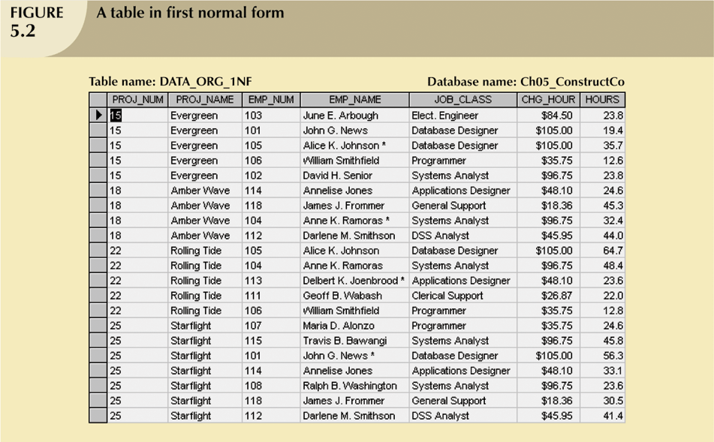
Conversion to First Normal Form (continued)
NORMALIZATION

Slide 17
Conversion to First Normal Form (continued)
Step 2: Identify the Primary Key
Primary key must uniquely identify attribute value
New key must be composed
Step 3: Identify All Dependencies
Dependencies can be depicted with help of a diagram
Dependency diagram:
Depicts all dependencies found within given table structure
Helpful in getting bird’s-eye view of all relationships among table’s attributes
Makes it less likely that will overlook an important dependency

Slide 18
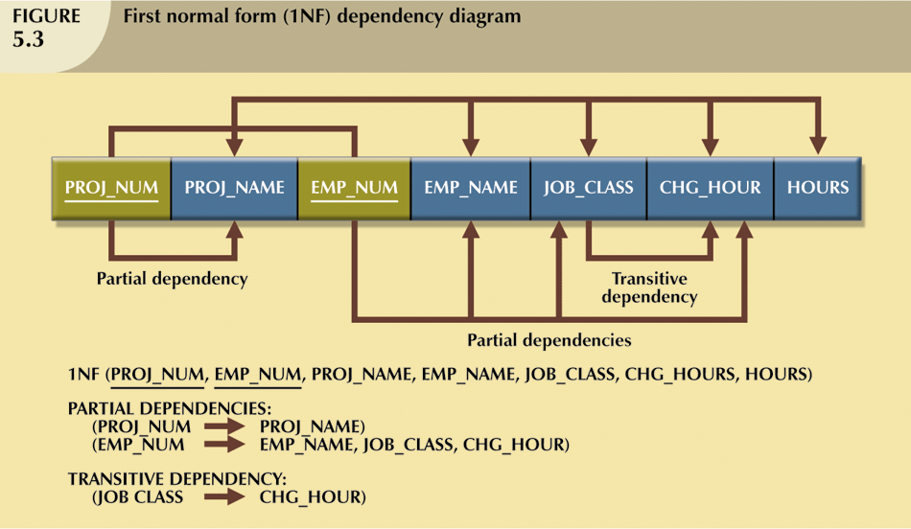
Conversion to First Normal Form (continued)

Slide 19
Conversion to Second Normal Form
Relational database design can be improved by converting the database into second normal form (2NF)
Two steps
Step 1: Write Each Key Component on a Separate Line
Write each key component on separate line, then write original (composite) key on last line
Each component will become key in new table
Step 2: Assign Corresponding Dependent Attributes
Determine those attributes that are dependent on other attributes
At this point, most anomalies have been eliminated

Slide 20
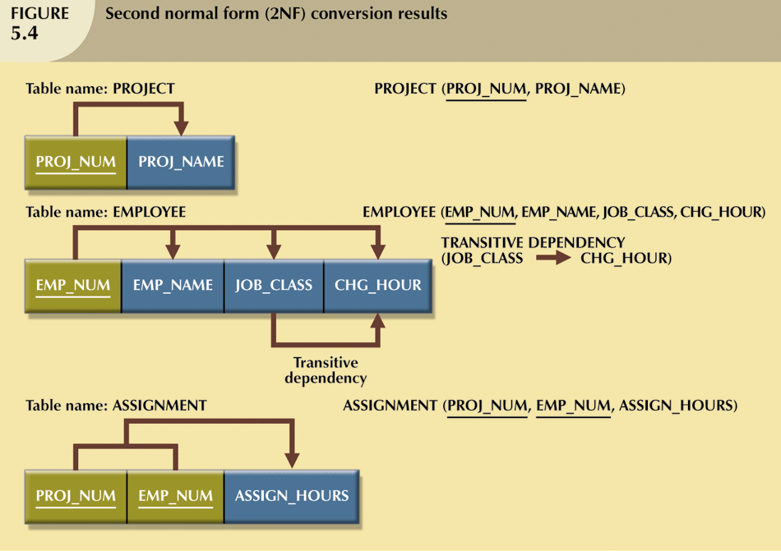
Conversion to Second Normal Form (continued)

Slide 21
Conversion to Second Normal Form (continued)
Table is in second normal form (2NF) when:
It is in 1NF and
It includes no partial dependencies:
No attribute is dependent on only portion of primary key

Slide 22
Conversion to Third Normal Form
Data anomalies created are easily eliminated by completing three steps
Step 1: Identify Each New Determinant
For every transitive dependency, write its determinant as PK for new table
Determinant
Any attribute whose value determines other values within a row
Step 2: Identify the Dependent Attributes
Identify attributes dependent on each determinant identified in Step 1 and identify dependency
Name table to reflect its contents and function

Slide 23
Conversion to Third Normal Form (continued)
Step 3: Remove the Dependent Attributes from Transitive Dependencies
Eliminate all dependent attributes in transitive relationship(s) from each of the tables that have such a transitive relationship
Draw new dependency diagram to show all tables defined in Steps 1–3
Check new tables as well as tables modified in Step 3 to make sure that each table has determinant and that no table contains inappropriate dependencies

Slide 24
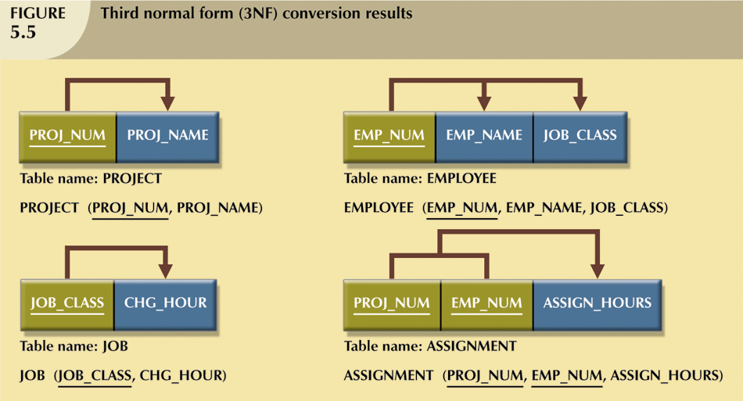
Conversion to Third Normal Form (continued)
A table is in third normal form (3NF) when both of the following are true:
It is in 2NF
It contains no transitive dependencies

Slide 25
The Boyce-Codd Normal Form (BCNF)
Every determinant in table is a candidate key
Has same characteristics as primary key, but for some reason, not chosen to be primary key
When table contains only one candidate key, the 3NF and the BCNF are equivalent
BCNF can be violated only when table contains more than one candidate key
Most designers consider the BCNF as special case of 3NF
Table is in 3NF when it is in 2NF and there are no transitive dependencies
Table can be in 3NF and fails to meet BCNF
No partial dependencies, nor does it contain transitive dependencies
A nonkey attribute is the determinant of a key attribute

Slide 26
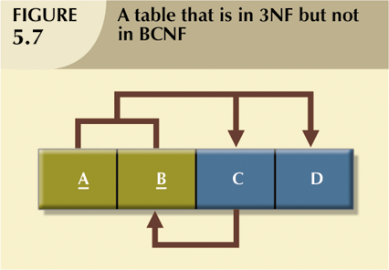
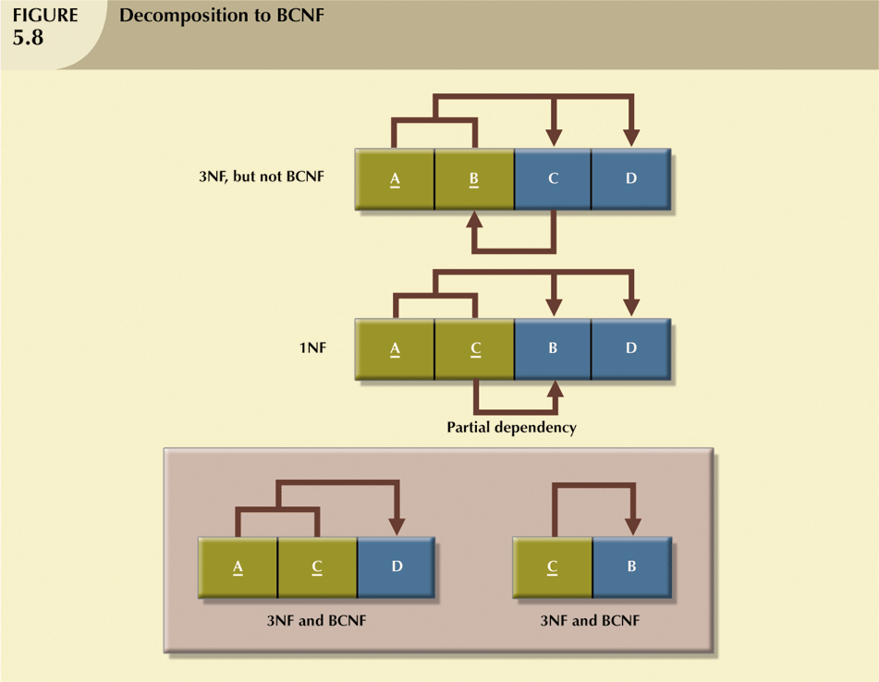
The Boyce-Codd Normal Form (BCNF) (continued)

Slide 27
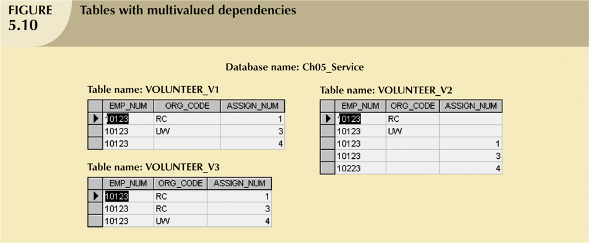
Fourth Normal Form (4NF)
Table is in fourth normal form (4NF) when both of the following are true:
It is in 3NF
Has no multiple sets of multivalued dependencies
4NF is largely academic if tables conform to following two rules:
All attributes must be dependent on primary key, but independent of each other
No row contains two or more multivalued facts about an entity

Slide 28
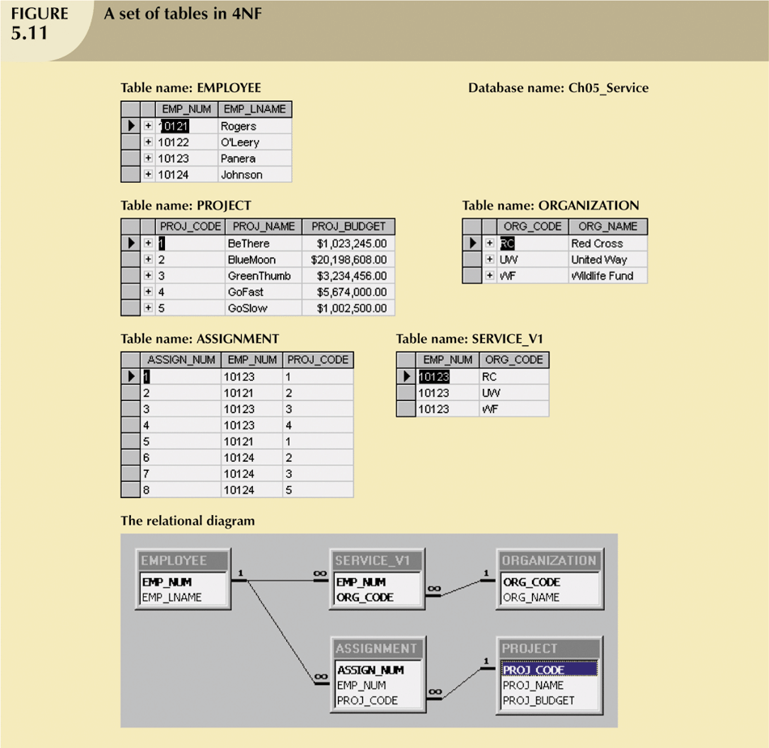
Fourth Normal Form (4NF) (continued)

